Slide 1
US06CMIC24
Fermentation Technology-II
UNIT-3: Industrial effluent treatment
Nature of effluent generated by fermentation industries
- Page no. 313
Dissolve oxygen as an indicator of water quality.- Page no. 314
Site surveys, Strength of fermentation effluent.
- Page no. 314-316
Treatment and disposal of industrial effluents- Sea and rivers,
Spray irrigation, Land fills and incineration, disposal of effluent in
sewers.- Page no. 316-318
Effluent treatment processes: Physical, Chemical and Biological.
- Page no. 318-326
By products- Distilleries and Breweries.- Page no. 316-327
Books name:
“Principles of fermentation technology, Stanbury, Whitaker and
Hall “

Slide 2
Nature of effluent generated by fermentation industries
EVERY fermentation plant utilizes raw materials which are
converted to a variety of products. Depending on the individual
process, varying amounts of a range of waste materials are
produced.
Typical wastes might include unconsumed inorganic and organic
media components, microbial cells and other suspended solids,
filter aids, waste wash water from cleansing operations, cooling
water, water containing traces of solvents, acids, alkalis, human
sewage, etc.
Historically, it was possible to dispose of wastes directly to a
convenient area of land or into a nearby watercourse. This cheap
and simple method of disposal is now very rarely possible, nor is
it environmentally desirable.
With increasing density of population and industrial expansion,
and greater awareness of the damage caused by pollution, there
is a need for treatment and controlled disposal of waste.

Slide 3
Water authorities and similar bodies have become more active in
combating pollution caused by domestic and industrial wastes.
Legislation in all developed countries now regulates the discharge
of wastes.
In the UK, much of the legislation pertaining to waste disposal
and pollution is embraced by the Environmental Pollution Act
1990 (HMSO, 1990, 1991).
With liquid wastes, it may be possible to dispose of untreated
effluents to a municipal sewage treatment works (STW).
Obviously, much will depend on the composition, strength and
volumetric flow rate of the effluent.
STWs are planned to operate with an effluent of a reasonably
constant composition at a steady flow rate.
Thus, if the discharge from an industrial process is large in
volume and intermittently produced it may be necessary to
install storage tanks on site to regulate the effluent flow.

Slide 4
In some locations, municipal sewers are not available or the
effluent may be of such a composition that the wastewater
treatment company or regulatory authority requires some form
of pretreatment before discharge to its sewers.
In these cases an effluent-treatment plant will have to be
installed at the factory.
Whatever the pollutant load of the liquid effluent, its discharge
to a sewer will be a cost centered activity, and will incur charges
from the treatment company.
Normally, fermentation effluents do not contain toxic materials
which directly affect the aquatic flora or fauna. Unfortunately,
most of the effluents do contain high levels of organic matter
which are readily oxidized by microbial attack and so drastically
deplete the dissolved oxygen concentration in the receiving
water unless there is a large dilution factor.

Slide 5
Effluent may be treated in a variety of ways, as will be outlined
later in this chapter.
In a number of processes it may be possible to recover waste
organic material as a solid and sell it as a by-product which may
be an animal feed supplement or a nutrient to use in
fermentation media.
The marketable by product helps to offset the cost of the
treatment process. It is now recognized that water is no longer a
cheap raw material.
Obviously the introduction of good "housekeeping will lead to
reductions in the volume of water used and the volume of
effluent for treatment and final discharge.
Recycling and reuse of materials, waste minimization, waste
reduction at source and integrated pollution control are now very
important factors to consider in the design and operation of any
manufacturing facility, and may be the subject of new legislation
in this field.

Slide 6
DISSOLVED OXYGEN CONCENTRATION AS AN INDICATOR OF WATER QUALITY
Since oxygen is essential for the survival of most macro-
organisms, it is important to ensure that there are adequate
levels of dissolved oxygen in rivers, lakes, reservoirs, etc., if they
are to be managed satisfactorily. Ideally, the oxygen
concentration should be at least 90% of the saturation
concentration at the ambient temperature and salinity of the
water.
It is therefore important to know how effluents containing
soluble and particulate organic matter can influence the
dissolved oxygen concentration.

Slide 7
Biochemical oxygen demand (BOD)
One widely used method of assessment is the biochemical
oxygen demand (BOD), which is a measure of the quantity of
oxygen required for the oxidation of organic matter in water, by
micro-organisms present, in a given time interval at given
temperature.
The oxygen concentration of the a effluent, or a dilution of it, is
determined before and after incubation in the dark at 20 ̊C for 5
days.
The oxygen decrease can then be determined titrimetrically
and the results presented as mg of oxygen consumed per dm³ of
sample.
Mineral nutrients and a suitable bacterial inoculum is usually
added to the initial sample to ensure optimal growth conditions.
This test is only an estimate of biodegradable material, hence
recalcitrant or inhibitory compounds might be over looked.

Slide 8
Chemical oxygen demand" (COD)
BOD test takes 5 days it may be necessary to resort to the
chemical oxygen demand" (COD), a chemical test which only
takes a few hours to complete.
The test is based on treating the sample with a known amount of
boiling acidic potassium dichromate solution for 2.5 to 4 hours
and then titrating the excess dichromate with ferrous sulphate or
ferrous ammonium sulphate.
The oxidized organic matter is taken as being proportional to the
potassium dichromate utilized.
Most compounds are oxidized virtually to completion in this test,
including those which are not biodegradable.
In circumstances where substances are toxic to microorganisms,
the COD test may be the only suitable method available for
assessing the degree of treatment required.

Slide 9
The BOD:COD ratios for sewage are normally between 0.2:1 and
0.5:1. The ratio values for domestic sewage may be fairly steady.
When industrial effluents of variable composition and loading are
discharged, the ratio may fluctuate considerably.
Very low BOD-COD ratios will indicate high concentrations of non
biodegradable organic matter and consequently biological
effluent treatment processes may be ineffective.
A number of alternative tests are available to indicate the oxygen
demand of a wastewater, including total organic carbon (TOC) and
permanganate value.

Slide 10
SITE SURVEYS
A complete survey of industrial operations is essential for any
individual site before an economical waste treatment programme
can be planned.
It is desirable to divide the facility into as many units as possible,
as knowledge of the various material streams may show
unexpected losses of finished product, solvent wastage, excessive
use of water or unnecessary contamination of water which might
be recycled, recovered or reused within the site.
The factors, and concentrations, (listed in Table) must be known
at all production rates under which an individual unit may
operate in a representative time period.
The survey may indicate a need for better control of water usage
and should identify sources of uncontaminated and contaminated
water that might be reused in the factory.
Concentrated waste streams should be kept separate if they
contain materials that can be profitably recovered.

Slide 11
Factors to investigate in a site survey
Daily flow rate
Fluctuations in daily, weekly and seasonal flow BOD/COD
Suspended solids
Turbidity
pH range
Temperature range
Odors and tastes
Color
Hardness
Detergents
Radioactivity
Presence of specific toxins or inhibitors (e.g. heavy metals, phenolics etc.)
It in also often more economical to treat a concentrate rather
than a large volume of a dilute effluent.
The various wastes may be tested in a laboratory and on a pilot
scale to assess the best potential methods of chemical and
biological treatment.

Slide 12
Once the pH of the effluents are known, samples may be mixed
to see if a neutral pH is reached.
A variety of tests may be used to establish methods for reducing
salt concentrations, coagulating suspended particles and colloidal
materials, and for breaking emulsions.
The commonly used biological tests include respirometry,
aeration-flask tests and continuous-culture experiments.
Small flask respirometers and oxygen electrodes are used initially
to establish the conditions to use in bio-oxidation of the effluent,
and to test for the presence of toxic materials.
Large respirometers (Simpson and Anderson. 1967) are useful for
predicting effluent treatment rates and oxygen requirements.
The residues in the flasks can be analyzed to see if there are any
recalcitrant materials.
The use of laboratory continuous-culture vessels fitted with
sludge return pumps and settling tanks can provide detailed
information.

Slide 13
Proposed large-scale operating conditions for feed and aeration
rates can be tested and their effectiveness assessed.
The results from all these experiments may help in the design of
a full-scale plant.
If the survey is comprehensive it should be possible to plan an
overall treatment programme for a site and to establish:
Water sources which can be combined or reused.
Concentrated waste streams which contain valuable wastes to be recovered as food, animal feed, fertilizer or fuel.
Toxic effluents needing special treatment, or acids or alkalis
needing neutralization.
4. The effluent loading expected under maximum production
conditions.
The effluent(s) which might be discharged directly, without
treatment, on to land or to a watercourse and not cause any pollution.
The effluent(s) which might be discharged into municipal sewers.

Slide 14
When all the relevant information has been obtained one can
predict the size and type of effluent treatment plant required, and thus its capital and operational costs.
This can then be compared with water company charges to treat the waste at an STW with and without on-site treatment.
It should be remembered that the water company may insist on onsite treatment before a waste is discharged to the sewer. and will in most cases set consent limits for maximum flow rates and concentrations of specific analytes.

Slide 15
THE STRENGTHS OF FERMENTATION EFFLUENTS
It is already evident from earlier sections of this chapter that the
presence of high levels of particulate or soluble organic matter in
water will result in potential high BOD.
An initial medium rich in organic matter is converted to biomass
and primary and secondary metabolites.
Unfortunately, the product often represents a small proportion of
the initial raw material, even in an efficiently operated
fermentation.
The spent wastes remaining after the distillation of whisky may
account for 90% of the initial raw organic materials, while in an
antibiotic fermentation the effluent may represent in excess of
95%.
The BODs of many of these samples are much higher than that of
domestic sewage and some may be comparable with strong
effluents such as sulphite paper mill liquor.

Slide 16
It is evident from these data that fermentation effluents may
present serious potential pollution problems and may be
expensive to dispose of unless well planned processes are used.
A number of steps may be taken to reduce BODs in a process.
Careful selection of raw materials may have a significant effect on
the type and quantities of effluent being produced.
The cheapest raw material which meets the nutrient
requirements of the micro-organisms may not be ideal if product
yield, recovery cost, effluent disposal cost and possible by-
product value are considered together.
The high BOD value of fungal mycelium (40.000 to 70,000 mg
dm⁻³ ) would indicate that any biomass should normally be kept
separate from the remainder of an effluent and some of it may be
sold as a by-product.

Slide 17
It may also be worthwhile to concentrate liquid fractions, for
example, industrial alcohol and distillery stillages (10,000 to
25,000 mg dm⁻³ ) will both produce dried soluble fractions which
can be sold.
Metabolites or components of some fermentation effluents may
be extremely toxic and polluting and will require complete
destruction, for example by chemical or thermal methods, before
disposal.
The need for such a treatment strategy will therefore make a
significant contribution to the overall cost of the process. One
such metabolite is avermectin produced by Streptomyces
avermitile fermentations. Here all effluent streams from the
process are captured and any avermectin present chemically
degraded.

Slide 18
Treatment and disposal of industrial effluents
The effluent disposal procedure which is finally adopted by a
particular manufacturer is determined by a number of factors.
The most important is the control exercised by the relevant
authorities in many countries on the quantity and quality of the
waste discharge and the way in which it might be done.
The range of effluent-disposal methods which can be
considered is:
The effluent is discharged to land, river or sea in an untreated
state.
The effluent is removed and disposed of in a landfill site or is incinerated.
The effluent is partially treated on site (e.g. by lagooning) prior to further treatment.
Part of the effluent is untreated and discharged as in 1 or 2, the remainder is treated at a sewage works or at the site before discharge.

Slide 19
All of the effluent is sent to the sewage works for treatment.
All the effluent is treated at the factory before discharge.
DISPOSAL
Seas and rivers
The simplest way of disposal will be on a sea coast or in a large
estuary where the effluent is discharged through a pipeline
(installed by the factory or local authorities) extending below
the low-water mark.
In such a case there may be little preliminary treatment which
depend on the degree of dilution in the sea water. If effluents
are to be discharged into a river they must meet the
requirements of the local river or drainage authorities.
In Britain there is a Royal Commission standard requiring a
maximum BOD (5 days) of 20 mg dm⁻³ and 30 mg dm⁻³ of
suspended solid matter (the 20:30 standard).

Slide 20
Stricter standards are often applied. levels of ammoniacal
nitrogen may be stipulated. As well as, often stringent upper
limits for toxic metals and chemicals which might kill the fauna
(particularly fish) and flora, e.g. sulphites, cyanides, phenols,
copper, zinc, cadmium, arsenic, etc.
Lagoons (oxidation ponds)
Lagoons, holding ponds, oxidation ponds, etc., may be used by
a number of industries if land is available at a reasonable cost.
It is a method often used in seasonal industries where capital
investment in effluent plant is difficult to justify.
The lagoon normally consists of a volume of shallow water
enclosed by watertight embankments.
Oxidation ponds are typically 1-2 m deep. They can be designed
to maintain aerobic conditions throughout, but more
commonly decomposition at the surface is aerobic and that
nearer the bottom is anacrobic and they are then known as
facultative ponds.

Slide 21
Oxygen for aerobic degradation is provided both from the
surface of the pond, and from algal photosynthesis.
Deeper ponds (known as lagoons) are mechanically agitated to
provide aeration.
Lagoons are simple to build and operate, but are expensive in
terms of land requirements.
They may be used as the sole method of treatment,
incorporating both physical (sedimentation) and biological
processes, but the effluent produced may not reach locally
acceptable standards.
Alternatively they can provide an initial pretreatment or can be
used to 'polish' effluent from secondary treatment processes.

Slide 22
Spray Irrigation
Liquid wastes can be applied directly to land as irrigation water
and fertilizer when they are claimed to have a number of
beneficial effects on the soil and plants. If this method of disposal
is to be used, then it is necessary to have a large area of land near
to a manufacturing plant in an area of low to medium rainfall.
Pipeline costs will often restrict use of this technique.
Colovos and Tinklenberg (1962) described the disposal of
antibiotic and steroid wastes with BODs of 5000 to 20,000
mg dm⁻³
These wastes were initially chlorinated to lower the BOD and
reduce unpleasant odors and then sprayed on to land until the
equivalent of 38 mm of rainfall was reached.
This process was repeated at monthly intervals and improved
plant growth When appropriate, solid wastes may be spread onto
land as a fertilizer and soil conditioner.

Slide 23
This practice is common with sewage sludges.
Mbagwu and Ekwealor (1990) report the use of spent brewers
grains to improve the productivity of fragile soils.
Irrespective of whether the waste is liquid or solid, the
concentration of heavy metals and certain organic components
will require careful monitoring and control to safeguard the
environment and public health.
Well disposal
Disused wells, boreholes or mine shafts may provide an ideal,
cheap method for disposal when the volume of waste is limited,
the underground strata are suitable and the chances of
contamination of water supplies utilized by water authorities are
negligible.
Melcher (1962) has described the use of wells 500-m deep for the
daily disposal of:.

Slide 24
Acetic acid 900 kg
Ammonium acetate 900 kg
Sodium acetate 760 kg
Sodium chloride 450 kg
Sodium and ammonium bromide 225 kg
Methanol, xylene, tars and organic compounds. This mixture had
a pH of 4 to 5 and a COD of 40,000 to 60,000 mg dm⁻³ rising to
100,000 mg dm⁻³ and was pumped into the wells at 50 to 100
dm⁻³ min⁻¹.
Careful hydro geological surveys will be needed to prove that
waste disposal in wells will not cause pollution of aquifers and
threaten groundwater supplies.

Slide 25
Land filling
Land filling is a disposal method for municipal solid waste (MSW)
and industrial waste. It utilizes natural or man made voids
(e.g. disused clay pits) into which the waste is deposited.
Both solid and liquid wastes can be deposited depending on
restrictions imposed by the site licence.
Strict controls exist on the amount of liquid and toxic materials
which can be accepted because of the threat of groundwater
pollution if leachate (a liquid having BOD levels up to 30,000 mg
dm⁻³) escapes from the site.
Leachate is generated from liquid deposited in the site, water
entering the site naturally via precipitation or surface run-off and
by anaerobic microbial action as organic matter in the landfill is
degraded.
Microbial action similar to that in anaerobic digesters leads to the
production of landfill gas (LFG) which, being 50-60 methane can,
if collected efficiently, provide a useful source of energy.

Slide 26
Incineration
A number of designs exist for the incineration of solid and/or
liquid wastes either on site or at a commercial incinerator,
including rotary kilns, fluidized beds and multiple hearth furnaces.
Combustion temperatures need to be carefully controlled to
destroy and prevent the formation of dioxins and furans,
formation of which occurs at between 300 ̊ and 800 ̊, and total
destruction is effected at temperatures above 1000 ̊ with
retention time of 1 second.
Flue gases from the incinerator require cleaning to remove
particulates, acid vapours, etc. using electrostatic precipitators,
cyclones and wet scrubbers to comply with local environmental
protection standards.
Waste disposal by incineration is currently significantly more
expensive than land filling, with costs for the disposal of MSW
being $37 tonne ⁻¹ for incineration compared with $10 tonne⁻¹ for
land filling.

Slide 27
Disposal of effluents to sewers
Municipal authorities and water treatment companies which accept trade effluents into their sewage systems will want to be sure that:
The sewage works has the capacity to cope with the estimated
volume of effluent.
The effluent will not interfere with the treatment processes used at the sewage works
There are no compounds present in the effluent which will pass through the sewage works unchanged and then cause problems when discharged into a water course.
It is common practice for local authorities to demand preliminary
on-site pretreatment before discharge into sewers to minimize the
effects of industrial wastes. The actual pretreatment required will
depend on the precise nature of the waste and may range from
simple sedimentation to complex chemical and biological
processes.

Slide 28
TREATMENT PROCESSES
Fermentation wastes may be treated on-site or at an STW by any or all of the three following methods:
Physical treatment
Chemical treatment
Biological treatment
Treatment processes may also be described in the following
manner:
Primary treatment: physical and chemical methods, e.g. sedimentation, coagulation etc.
Secondary treatment; biological methods (e.g. activated sludge) conducted after primary treatment.
Tertiary treatment; physical, chemical or biological methods (e.g. microstrainers, sand filters and grass plot irrigation) used to improve the quality of liquor from previous stages.

Slide 29
Sludge conditioning and disposal; physical, chemical and biological methods. Anaerobic digestion is often used to condition the sludge produced in previous stages. Following dewatering (e.g. by centrifugation using a decanter centrifuge) the sludge can then be disposed of by incineration, land filling, etc.
Physical treatment
The removal of suspended solids by physical methods before
subsequent biological treatment will considerably reduce the
BOD of the resulting effluent.
In nearly all fermentation processes the cells are separated
from the liquid fraction in recovery processes, Obviously,
biomass processes need not be considered, Yeast cells from
other processes may be a marketable product, but microbial
cells may not always be marketable, particularly when
contaminated with filter aid.

Slide 30
In these instances, when the cells and filter aid are a waste, the recovered material may be dealt with in two basic ways:
The waste is disposed of without any further treatment
The waste bulk is reduced by mechanical dewatering with a
filter press, centrifuge, rotary vacuum filter or belt press. The
compressed waste is then incinerated or disposed of in a
landfill site.
Physical processes installed for primary effluent treatment may include the following stages:
Screens, to remove larger suspended and floating matter
Comminutors, to reduce particle size,
Constant velocity channels (~ 0.3 ms) for grit removal to
prevent damage to plant in later processes
Sedimentation tanks for the removal of finer suspended matter.
These are generally circular or rectangular continuous flow
tanks operating at retention times of 6-15 hours (and designed
to have a minimum retention time of 2 hours), with facility for

Slide 31
the continuous removal of settled sludge. Sedimentation tanks
can remove 70% of the incoming suspended solids and,
depending on the nature of the waste, up to 40% of its BOD
load. They can be operated with or without prior chemical
coagulation/flocculation.
Physical processes used in tertiary treatment to produce an
effluent of better quality than the 30:20 standard include
microstrainers, slow sand filters, up flow sand filters and rapid
gravity sand filters. Throughputs vary between around 3 m³ m⁻²
day⁻¹ for slow sand liters and 700 m³ m⁻² day⁻¹ for
microstrainers. Suspended solids removal is generally 50 - 70%
and BOD removal around 30-50%, depending on the technique
used.

Slide 32
Chemical treatment
Fine suspended particles in an effluent may be removed by
coagulation and/or flocculation. Coagulation is essentially
instantaneous whereas flocculation requires some more time
and gentle agitation to achieve "aggregation' of the particles.
Ferrous or ferric sulphate, aluminium sulphate (alum), calcium
hydroxide (lime) and polyelectrolyte are often used as chemical
coagulants.
A solution of coagulant of the appropriate strength for effective
treatment is added to the effluent in a vigorously mixed tank, a
precipitate or floc forms almost immediately and carries down
the suspended solids to form a sludge.
This sludge may be drawn off, mechanically dewatered and
subjected to further treatment.
The flocs formed on coagulation may be small, and will therefore
require an extended period to settle, and as a consequence, for
a given throughput of effluent a large sedimentation tank will be
needed.

Slide 33
Increasing the particle diameter by encouraging small flocs to
coalesce (flocculation) increases the rate of sedimentation and
thus for a given throughput, a smaller vessel can be operated.
Polyelectrolyte are commonly used as flocculants, and
following addition the effluent is gently mixed (turbulent mixing
would break up the flocs) by passage through sinuous
flocculation channels, hydro dynamic flocculators or
mechanically mixed flocculators.
Biological treatment
Most organic waste materials may be degraded biologically. This
process may be achieved aerobically or anaerobically in a
number of ways.
The most widely used aerobic processes are trickling filters,
rotating disc contactors, activated sludge processes and their
modifications. The anaerobic processes (digestion, filtration und
sludge blankets) are used both in the treatment of specific
wastewaters and in sludge conditioning.

Slide 34
Aerobic processes
TRICKLING FILTERS
The trickling filter is not one of filtration, but rather it is a fixed
film bio-reactor. Settled effluent to be treated is passed down
through a packed bed counter current to a flow of air.
Micro-organisms adhering to the packing matrix adsorb oxygen
from the up flowing air and organic matter from the down
flowing effluent; organic matter is then metabolized and the
effluent stream's BOD reduced.
A conventional trickling filter usually consists of a cylindrical
concrete tank 2 to 3 m in depth and 8 to 16 m in diameter. Some
filters are rectangular in shape, but a rotary system allows more
uniform - hydraulic loading.
The tank is packed with a bed of - stone (usually granite) or
special plastic packings, the y bed being under laid with drains.

Slide 35
The packing material diameter should be 50 to 100 mm to give a
specific a surface of around 100 m³ m⁻², and the material should
be packed to give a voidage (% air space of total bed volume) of
45 to 55%, which should minimize the risk of the spaces
between the packing material becoming a blocked by the
microbial film.
Synthetic packing material, although more expensive, has a
higher surface area and voidage, allowing higher treatment rates
per unit volume of bed and reducing the likelihood of blockages.
The trickling filter is always followed by a secondary
sedimentation tank or humus tank to re move suspended matter
(e.g. biofilm sloughed off the packing) from the treated effluent.
In conventionally loaded or low-rate filters, the effluent from
which the suspended solids have been removed, is fed on to the
upper surface of the bed by spray nozzles or mechanical
distributor arms.

Slide 36
The effluent trickles gradually through the bed and a slime layer
of biologically active material (bacteria. fungi, algae, protozoa
and nematodes) forms on the surface of the support material.
The large surface area created in the bed permits close contact
between air flowing upwards through the bed, the descending
effluent and the biologically active growth.
The bacteria in the biological film remove the majority of the
organic loading. Complex organic materials are broken down and
utilized, nitrogenous matter and ammonia are oxidized to
nitrates and sulphides and other compounds are similarly
oxidized.
The higher organisms (protozoa etc.) control the accumulation of
the biological film (prevents the filter from blocking) and improve
the settling characteristics of the solids (humus) discharged with
the filter effluent.

Slide 37
The simple filter is inefficient when operated at abnormally high
organic loading rates Initially, there is a very rapid build up of
bacteria, fungi and algae at the top of the filter which cannot be
controlled by the resident population of worms and larvae.
A trickling filter bed should remove 75 to 95% of the BOD and 90
to 95% of the suspended solids at organic loading rates of 0.06-
0.12 kg BOD m⁻³ day⁻¹ for conventional trickling filtration.
When part of the treated effluent is being recirculated to dilute
the feed and increase the hydraulic load placed on the unit the
organic loading can be increased to 0.9-0.15 kg BOD m⁻³day⁻¹.
To achieve the Royal Commission (20:30) Standard together with
a high degree of nitrification, filters being supplied with domestic
sewage should receive organic loading rates of 0.07-0 7-0.1 kg
BOD m⁻³ day⁻¹ and hydraulic loading rates of 0.12-0.6 m⁻³m⁻³day⁻¹.

Slide 38
It is possible to modify the trickling filter to increase the capacity
for organic loading by the use of two sets of filters and settling
tanks in series, this is known as alternating double filtration (ADF).
Effluent is applied to the first filter at a high hydraulic and organic
loading rate, it passes from this filter through the first settling tank
and then on to a second filter and settler. After a period of one to
two weeks the sequence of the filters is reversed and the second
filter receives the higher loading.
In this way heavy film growth is promoted in the first filter to
receive the effluent, but when the filter sequence is reversed it
becomes nutrient limited, encouraging excess film removal.
Loading rates of 0.32 - 0.47 kg BOD m⁻³ day⁻¹ have been claimed,
but recommended rates for design purposes are 0.15-0.26 kg BOD
m⁻³ day⁻¹.

Slide 39
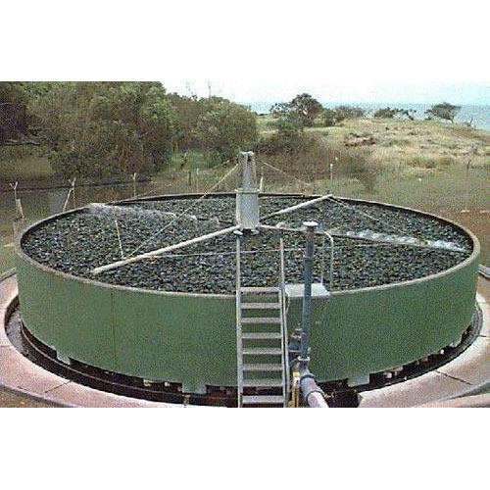
Alternatively, enclosed deep beds of 3.5 to 5.5 m depth may be
used in which air is blown through the beds by fans. Loading rates
up to 12 times that of the ordinary filter have been claimed.

Slide 40
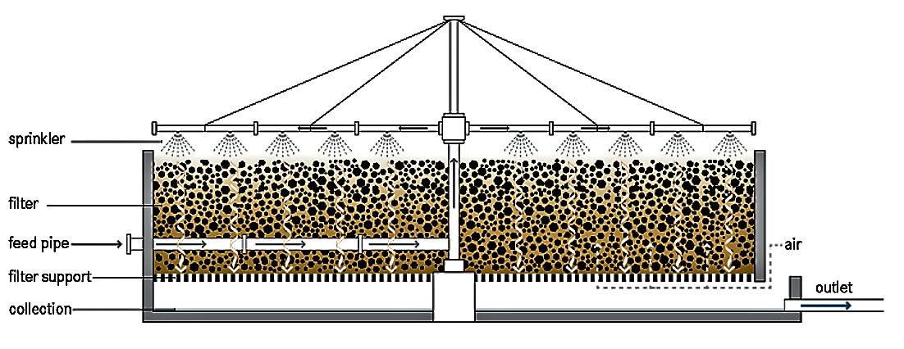

Slide 41
TOWERS
Trickling filters do not have both a high specific area and a high
voidage, they are less suitable for the treatment of large volumes
of strong industrial effluents.
Large areas of land would be required for the expensive and
extensive traditional filter beds.
Towers, 6-9 m in height, packed with light weight (40-80 kg m⁻³)
plastic multi-faced modules or small random packing units have
provided to be a space saving and relatively inexpensive solution
to the problem.
These packings have a relatively open structure for oxygen
transfer (specific surface of 100-300 m² m⁻³) and high voidage
(90-98 %), but are expensive compared with the conventional
filter packings.
They are capable of coping with high BOD loadings.

Slide 42
At a loading of 3.2 kg BOD m⁻³ day⁻¹ a 50% BOD removal may be
achieved, and at a 1.5 kg m⁻³ day⁻¹ 70% removal is possible
(Ripley, 1979).
The biological film is similar to that formed on the conventional
packing and scouring is due to the hydraulic load applied rather
than the predation of higher organisms.

Slide 43
BIOLOGICALLY AFRATED FILTERS (BAFS)
Biologically aerated filters are a relatively recent development
based on the trickling filter. They consist s of a packed bed which
provides sites for microbial growth through which air is passed
but, unlike trickling filters, the reactor volume is flooded with the
effluent to be treated which is passed upwards or downwards to
the through the reactor (i.e. co or counter currently to air supply)
depending on the design.
The packing matrix may be natural (e.g. pumice) or synthetic (e.g.
polyethylene), and may be either a fixed structure or randomly
packed.
The combination of aeration and filtration allows high rates of
BOD and ammonia removal together with solids capture, so that
sedimentation tanks may not be required. However, regular
backwashing is essential to remove filtered solids and excess
biomass.

Slide 44
Organic loading rates for 90% BOD removal are significantly
greater than those obtained for trickling filters, being in the range
0.7-2.8 kg BOD m⁻³ day⁻¹ (Stephenson et al., 1993).
They are versatile treatment systems, and of those currently in
operation, design capacities vary between 600 and 70,000 m⁻³
day⁻¹ .
In addition to their use as a secondary treatment process they can
also be utilized for tertiary treatment or modified to allow
denitrification in a manner similar to that of activated sludge
systems.

Slide 45
ROTATING BIOLOGICAL CONTACTORS (ROTATING DISC CONTACTORS)
In this treatment method a unit composed of closely spaced
discs (2 to 3 m diameter with 1 to 2 cm spacing between discs),
on a central drive shaft are rotated slowly (0.5 to 15 rpm)
through the effluent so, that 40 to 50% of the disc surfaces are
submerged.
The discs, usually made from synthetic material (e.g. polystyrene,
PVC), are arranged in stages or groups separated by baffles to
minimize short circuiting or surging and to enhance specific
treatment requirements such as nitrification.
The discs may be flat or corrugated to increase surface area.
A microbial film forms on the discs, this is aerated during the
exposed part of the cycle and absorbs nutrients during the
submerged part.

Slide 46
Shear forces produced as the discs rotate through the liquid
control the thickness of the biofilm, with excess biofilm being
sloughed from the discs.
A sedimentation tank following the biological stage is therefore
required to remove biological solids.
Loading rates of 13 g BOD m⁻³ day⁻¹ for domestic sewage and
partial treatment of liquids of 400 g BOD m⁻³ day⁻¹ have been
used. To achieve the 20:30 standard the loading rate should not
exceed 6 g BOD m⁻³ day⁻¹.
Rotating biological contactors are compact, easily covered for
health and aesthetic reasons, available as packaged units,
simpler to operate under varying loads than trickling filters (the
biofilm being wetted at all times) and are easily added onto
existing treatment processes.
As such they can provide a cost effective method of on-site
treatment.

Slide 47
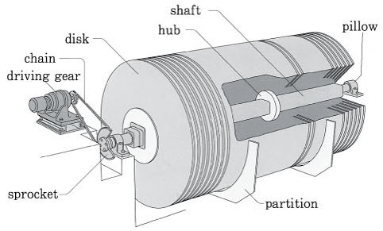
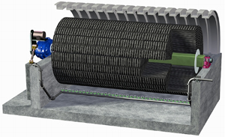
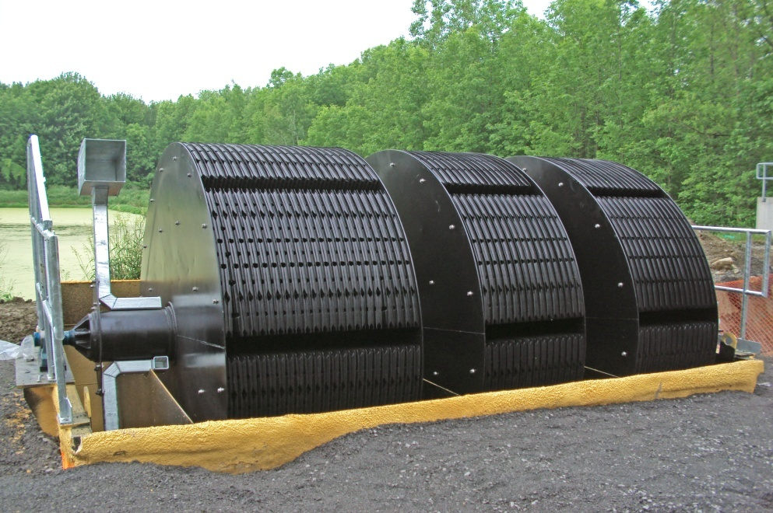

Slide 48
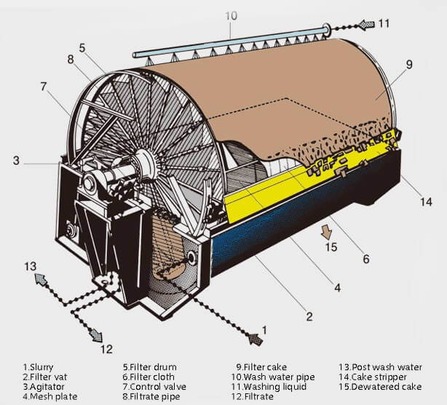
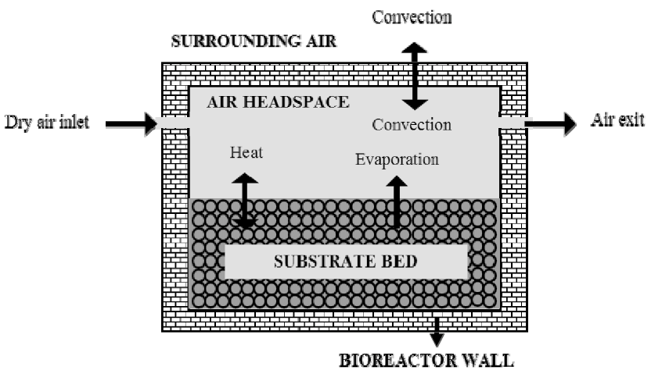
ROTATING DRUMS
Large rotating drums packed with random plastic packing
materials or spheres have been manufactured as a development
of rotating discs.
Loading rates for the random packing were similar to those of
rotating discs, while plastic spheres used in partial treatment
could cope with loads of 6 kg BOD m⁻³ day⁻¹.

Slide 49
FLUIDIZED-BED SYSTEMS
Fluidized bed reactors in wastewater treatment are relatively
recent innovations.
The support matrix (sand, anthracite, reticulated foam) has a
large surface area on which the biofilm adheres and thus they
are able to operate at high biomass concentrations with high
rates of treatment.
This allows strong wastewaters to be treated in small reactors.
They are also useful for the treatment of industrial wastewaters
when variable loadings are encountered.
The support matrix is fluidized by the up flow of effluent through
the reactor, and the degree of bed expansion is controlled by the
flow rate of wastewater.
The treated effluent can thus be decanted off without loss of the
support matrix and with careful operation a secondary
sedimentation tank may not be needed.

Slide 50
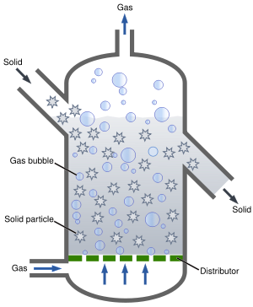
The support matrix is regularly withdrawn to remove excess
biomass.
Fluidized bed systems can be operated aerobically, anaerobically
or anoxically for denitrification.

Slide 51
ACTIVATED SLUDGE PROCESSES
The basic activated sludge process consists of aerating and
agitating the effluent in the presence of a flocculated suspension
of micro-organisms on particulate organic matter -- the activated
sludge.
This process was first reported by Arden and Locket (1914) and is
now the most widely used biological treatment process for both
domestic and industrial wastewaters.
The raw effluent enter a primary sedimentation tank where
coarse solids are removed. The partially clarified effluent passes
to a second vessel, which can be of a variety of designs, into
which air or oxygen is injected by bubble diffusers, paddles,
stirrers, surface aerators etc.
Vigorous agitation is used to ensure that the effluent and oxygen
are in contact with the activated sludge. After a predetermined
residence time of several hours, the effluent passes to a second
sedimentation tank to remove the flocculated solids.

Slide 52
Part of the sludge from the settlement tank is recycled to the
aeration tank to maintain the biological activity.
The overflow obtained from the settlement tank should be of a
20:30 standard or better and be suitable for discharge to inland
waters.
The excess sludge is dewatered and dried, to be sold as a fertilizer,
incinerated or landfilled.
In conventional activated sludge processes, organic loading rates
are 0.5-1.5 kg BOD m⁻³ day⁻¹ with hydraulic retention times of 5-14
hours depending on the nature of the wastewater, giving BOD
reductions of 90-95%.
High-rate activated-sludge processes can be used as a partial
treatment for strong wastes prior to further treatment or discharge
to a sewer and are widely used in the food processing and dairy
industries. The organic loading rate is 1.5 3.5 kg BOD m⁻³ day⁻¹and
with hydraulic retention times of only 1-2 hours. BOD reductions of
60-70% are possible.

Slide 53
A number of modifications of the basic process can be used to
improve treatment efficiency, or for a more specific purpose such
as denitrification.
Tapered aeration and stepped feed aeration are used to balance
oxygen demand with the amount of oxygen supplied.
Contact stabilization exploits biosorption processes and thereby
allows considerable reduction in basin capacity ( 50%) for a given
wastewater throughput.
Denitrification (the biological reduction of nitrate to nitrite and
on to nitrogen gas under anoxic conditions) can be accomplished
in an activated-sludge plant when the first part of the basin is not
aerated.
In advanced activated-sludge systems the amount of dissolved
oxygen available for biological activity is increased to improve
treatment rate.

Slide 54
One vessel of this d type is the 'Deep Shaft". The 'Deep Shaft
consists of a shaft 50 to 150 m deep, separated into a down-flow
section (down-comer) and an up-flow section (riser).
The shaft may be 0.5 to 10 m diameter, depending on capacity.
Fresh effluent is fed in at the top of the 'Deep Shaft' and air is
injected into the down-flow section at a sufficient depth to make
the liquid circulate at 1 to 2 m s⁻¹.
The driving force for circulation is created by the difference in
density (due to air bubble volume) between the riser and down-
flow sections.
For starting up, circulation of liquid is stimulated by injecting air
at the same depth in the riser.
BOD removal rates of 90% are achievable at organic loadings of
3.7-6.6 kg BOD m⁻³ day⁻¹ at hydraulic retention times of 1.17-1.75
hours (Gray, 1989)

Slide 55
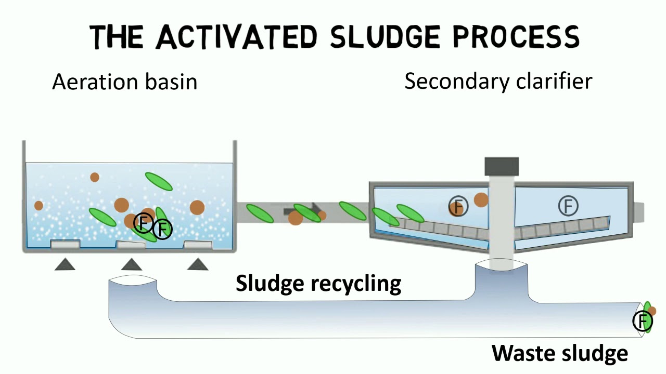

Slide 56
Sludge reproduction was found to be much less than that for
conventional sewage treatment processes.
Two types of pure oxygen systems have also been developed to
increase the rate of oxygen transfer:
Closed systems which operate in oxygen rich atmospheres.
Open systems employing fine bubble diffusers.
An example of the closed system is the UNOX. Process
developed by the Union Carbide Corporation in the U.S.A., and
marketed in the U.K. by Wimpey Unox.
Organic loading rates (when treating municipal wastewater) are
3-4 times higher than those of aerated systems at 25-4.0 kg
BOD m⁻³ day⁻¹
The UNOX process has been successfully used for the treatment
of brewery wastewaters containing 2000 mg BOD dm⁻³ flow
rates of 2269 m⁻³ day⁻¹ with a 6.6 hour retention time.

Slide 57
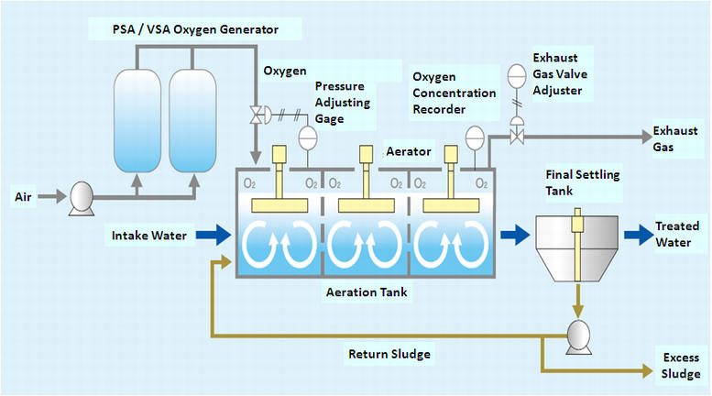

Slide 58
The VITOX aeration system developed by the British Oxygen
Company is an example of an open tank oxygenation system. Its
main advantage is that it can be used in existing aeration tanks
either to replace or upgrade conventional aeration without the
need to replace or modify existing units.
Oxygenation in achieved by pumping settled wastewater
high pressure through a venturi where oxygen is injected.
Turbulence and high pressures thus created ensure high levels
of oxygen dissolution.
The flexibility of this system means that it is particularly useful
for the treatment of high strength intermittently produced
wastewaters such as those generated by food processing
industries.

Slide 59
Anaerobic treatment
Anaerobic treatment of waste organic materials originated with
the use of septic tanks and Imhoff tanks, which have now been
replaced by a variety of high-rate digesters.
Loehr (1968) has listed the following reasons for using anaerobic
processes for waste treatment:
Higher loading rates can be achieved than are possible for
aerobic treatment techniques.
Lower power requirements may be needed per unit of BOD treated.
Useful end-products such as digested sludge and/or combustible gases may be produced.
Organic matter is metabolized to a stable form.
There is an alteration of water-binding characteristics to permit rapid sludge dewatering.

Slide 60
6. The reduced amount of microbial biomass leads to easier handling of sludge.
Low levels of microbial growth will decrease the possible need for supplementary nutrients with nutritionally unbalanced wastes.
ANAEROBIC DIGESTION
Large volumes of wet sludge which are produced in primary
and secondary sedimentation tanks may have to be reduced in
volume before disposal.
This volume of sludge can be reduced by anaerobic digestion.
In sludges containing 20000-60,000 mg dm⁻³ solid matter, 80%
of the degradable matter may be digested which will reduce
the solids content by 50%.

Slide 61
During anaerobic digestion acid fermenting bacteria degrade
the waste to free volatile fatty acids, mainly acetic and
propionic acid, which are then converted to methane (60 %)
and carbon dioxide (40%).
The gas produced (biogas) is a very useful by product, and can
be burnt as a heating fuel, fed to gas engines to generate
electricity or used as a vehicle fuel.
As well as being used in sludge digestion and conditioning,
anaerobic digesters are also used directly in the treatment of
many high strength wastewaters, for example from the food
and agricultural industries.
A number of anaerobic processes have been developed,
completely mixed reactors (often these are simply described as
anaerobic digesters) with or without sludge recycle, anaerobic
filters, up-flow anaerobic sludge blankets (UASB) and anaerobic
fluidized beds are the most common.

Slide 62
Two stage anaerobic treatment systems utilizing a short
retention time completely mixed acidification reactor followed
by a UASB methanogenic reactor have been reported.
Benefits claimed include improved reliability, higher BOD/COD
reductions and greater methane productivity.

Slide 63
ANAEROBIC DIGESTERS
The digester tanks used for this process may be up to 12,000-m³
volume and equipped with heating coils for accurate
temperature control normally in the mesophilic range (25°-38°,
usually 28°-32° in anaerobic digestion) to increase the rate of
digestion, which is also improved by mechanical agitation.
Some digesters are operated thermophilically (50°-70°, usually
55°- 65° in anaerobic digestion) to increase the rate of
degradation and biogas production, though much of the extra
gas produced will be consumed in maintaining the digester
temperature.
The use of thermophilic anaerobic digestion has been
investigated for the treatment of high strength (16-25 g COD
dm⁻³ ). low pH (- 3.8) and high temperature winery effluents.

Slide 64
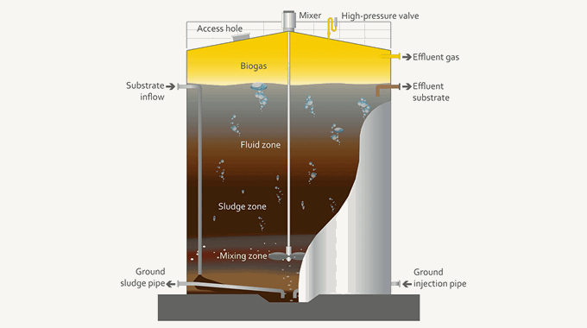

Slide 65
Wiegant et al. (1985) reported the successful application of
thermophilic anaerobic digestion of vinasse in completely mixed
and UASB reactors, although methane production was found to
decrease at high loading rates due to the presence of inhibitory
compounds.
Most digesters operate on a semi-continuous basis with
the appropriate volume of digested material being removed and
replaced with fresh' material on a daily basis.

Slide 66
ANAEROBIC FILTERS
In anaerobic filters, as with the aerobic filters, there is a
microbial film growing on an inert support.
Anaerobic filters may be operated in an upflow or downflow
mode, and a wide variety of packings are used; both natural and
synthetic.
The first full-scale anaerobic filters were constructed in the
1970s and in 1982 the Bacardi Corporation brought into
operation a 100,000 m⁻³ plant to treat distillery effluents.
Many other effluents are found to be amenable to treatment
using anaerobic filter systems, antibiotic fermentation wastes,
citric acid fermentation wastes, yeast production wastewater and
brewery and winery wastewaters, molasses distillery slops and
fermentation and pharmaceutical wastes.

Slide 67
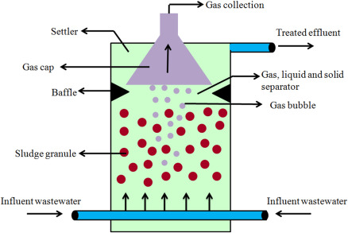

Slide 68
UP-FLOW ANAEROBIC SLUDGE BLANKETS (UASB)
In this system (originally developed in the Nether lands) high
levels of active biomass are retained in the reactor by
flocculation.
No support media is added to the reactor, instead the
flocculated sludge develops in the reactor and acts as a fluidized
bed.
Feed is pumped through the bed (the sludge blanket), above
which fine particles flocculate and settle back to the blanket as
sludge, thus preventing washout of organisms.
Anaerobic sludge blankets have been found to be effective in the
treatment of many wastewaters, including sugar-beet wastes,
domestic sewage, slaughterhouse wastes, agricultural wastes,
brewery wastes, winery wastes and Distillery wastes.

Slide 69
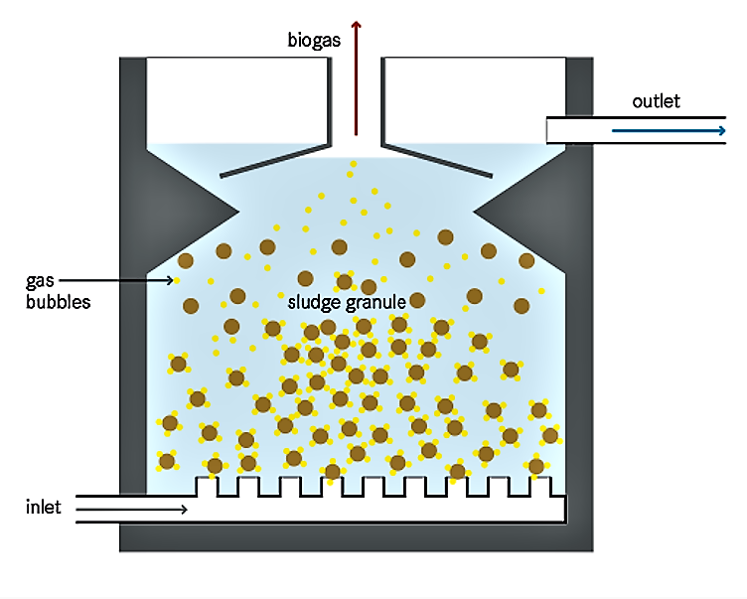

Slide 70
BY-PRODUCTS
The marketing of wastes from fermentation processes has been
established for at least 200 years. By the 1700, brewers grains,
spent hops and surplus yeast from larger breweries were
accumulating in sufficient quantities for specialized trades to
develop (Mathias, t 1959).
In any fermentation recovery process there is a need to
recognize whether there is a potential marketable waste and, if
necessary, to develop a market.
Obviously the marketability and cost of roclamation of
by-products will be very important in deciding upon a policy of
waste recovery.
Under favorable market conditions has been claimed that the
profit on animal feed by products from a completely Integrated
distillery may almost pay the cost of the grain (Blaine, 1965).

Slide 71
Some microbial processes yield residues which are difficult or
impossible to sell (Blaine, 1965).
In these processes it may be possible, and worth while, to
change to low residue raw materials such as refined sugars or
other pure compounds as sources of soluble nutrients.
Distilleries
In grain based distilleries it has been common practice to recover
spent grain and stillage, the waste liquor after the alcohol has
been distilled off.
The stillage is first passed through screens with 1-mm openings.
The screenings are then dewatered with mechanical filter
presses and dried in rotary driers.
This product is termed Distillers Dried Grains (light grains). The
screened stillage is concentrated in evaporators to give 25 to 35%
solids in a thick syrup.

Slide 72
Stillages which have been pre filtered may be concentrated to 35
to 50% solids. This syrup can then be mixed with the pressed
screenings and dried to give Distillers Dried Grains with Soluble
(dark grains).
Alternatively the evaporated stillage may be dried completely in
drum driers to produce Distillers Dried Soluble. Dark and light
grains and dried soluble have all been used as animal-feed
supplements.
Flachowsky et al. (1990) report their use following chemical
treatment as a replacement feed for sheep. Dried soluble have
also been used as a medium adjunct in the preparation of
antibiotics.
In distilleries using cane molasses as a feedstock, evaporated
spent wash has been used as a fuel for boilers, It has proved
worth while to recover potassium salts from sugar beet stillage.
The market for the evaporated product must be considered
within a range of 50 km of the evaporation plant.

Slide 73
Borut (1953) cited an unpublished 1949 survey of American
distilleries which showed that 85% of the stillage solids were
being recovered as dried feeds, 14% solids as wet grains and only
1% was waste.
In recent years the traditional distillers' by-products from stillage
have become increasingly uneconomic.
A number of processes to produce SCP from stillage using
Geotrichum candidum, Candida utilis or Candida tropicalia have
been evaluated.

Slide 74
Breweries
The three marketable wastes from breweries are spent grain,
spent hops and yeast. The spent grain is recovered from the
mash tun and is then sold as animal feed either after pressing in
a wet state or after drying in rotary driers.
Alternatively, the wet grain may be used in the preparation of
silage for cattle. The possible markets for hops are restricted.
Some are used as a fertilizer or as a low-grade fuel.
Yeast can be separated from beer by filtration or centrifuging.
The yeast slurry is then dried in drum driers. Some of the yeast
may be mixed with brewers' spent grains to produce a feed
material with a slightly higher protein content than normal
brewers' grains.
The yeast may also be used directly as a source of vitamins. If it
is to be used as a human food it must be debittered to remove
the hop bitter substances absorbed on to the yeast cells.

Slide 75
The cells are then washed in an alkaline solution, washed with
water and drum dried. Although bakers' yeast was originally
obtained as a brewery by-product, this market has diminished
considerably.
Most bakers' yeast is now produced directly by a distinct
production process.
Dewatered sludge from brewery wastewater treatment
operations has been reported to increase agricultural yields
when used as fertilizer.
Lyons (1983) reports on the potential use of brewery effluents as
a feedstock for fuel and industrial ethanol production.

Slide 76
Amino acid wastes
The main wastes from glutamic acid or lysine fermentations are cells, a liquor with a high amino acid content which can be used as an animal-feed supplement, and the salts removed from the liquor by crystallization, which is a good fertilizer.
Fuel alcohol wastes
The stillage from ethanol production and wastes from starchy fermentations are, following concentration, saleable as an animal feed supplement Wastes from sugar fermentations and distillation can be digested anaerobically and the methane generated used as an energy source. Faust al. (1983) also suggest the use of CO₂ rich off gases in the food and beverage industries.

